Slide 1
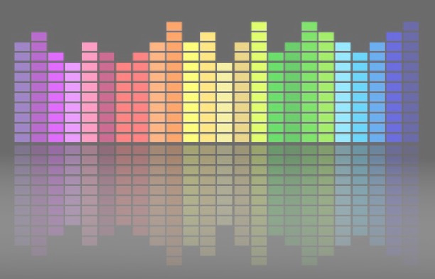

Computational Music Analysis: Audio
A.K.A. “Audio Content Analysis”
1. Course Introduction
Claire Arthur
Noël Alben

Slide 2
Agenda
What is A Sine Wave
What is a function?
How do we define a Sine Wave
Activity Of Computing Similarity
The story of Fourier Transform
Fourier Series
Fourier Transform
Discrete Fourier Transform
Why do we Care?
(Activity) How Fourier Transform Works Today
Properties Of Discrete FFT
STFT

Slide 3

Agenda
What is A Sine Wave
What is a function?
How do we define a Sine Wave
Activity Of Computing Similarity
The story of Fourier Transform
Fourier Series
Fourier Transform
Discrete Fourier Transform
Why do we Care?
How Fourier Transform Works Today
Properties Of Discrete FFT
STFT
Windowing
Spectrogram
Time vs Frequency Duality
Why???
https://musiclab.chromeexperiments.com/spectrogram

Slide 4

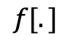
Functions
What is a Function?
a function yields relation between a set of input elements and a set of output elements
$$f[.]$$
1
2
3
4
5
6
1
4
9
16
25
26

Slide 5
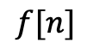
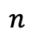
Functions
What is a Function?
a function yields relation between a set of input elements and a set of output elements
$$n$$
$$f[.]$$
$$f[n]$$
1
2
3
4
5
6
1
4
9
16
25
26

Slide 6
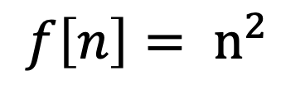
Functions
What is a Function?
a function yields relation between a set of input elements and a set of output elements
$$n$$
$$f[.]$$
$$f[n]$$
1
2
3
4
5
6
1
4
9
16
25
26
$$f\left[n\right]= n^{2}$$

Slide 7
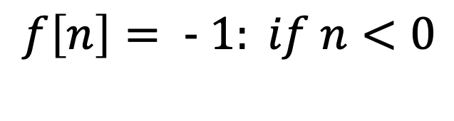
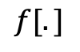
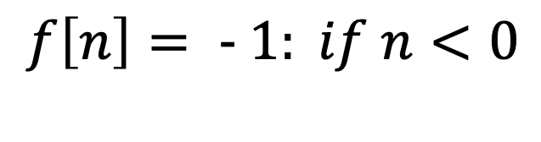
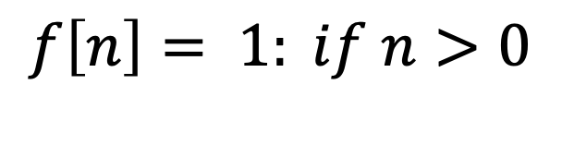
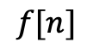
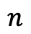
Functions
What is a Function?
a function yields relation between a set of input elements and a set of output elements
$$n$$
$$f[.]$$
$$f[n]$$
$$f\left[n\right]= 1: if n>0$$
$$f\left[n\right]= − 1: if n<0$$
-3
-2
-1
0
1
2
-1
0
1
$$f\left[n\right]= − 1: if n<0$$

Slide 8
Functions
What is a Function?
a function yields relation between a set of input elements and a set of output elements
$$n$$
$$f[.]$$
$$f[n]$$
https://www.desmos.com/calculator/9useprq8i8
-3
-2
-1
0
1
2
-1
0
1

Slide 9
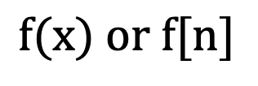
Sine Wave
Properties Of Function
Continuous Vs Discrete
Symmetry Properties
Even Functions
Odd Functions
Periodic
A-periodic
Linear
4. Orthogonality
$$f(x) or f[n]$$

Slide 10
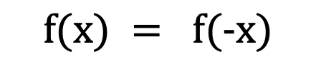
Sine Wave
Properties Of Function
Continuous Vs Discrete
Symmetry Properties
Even Functions
Odd Functions
Periodic
A-periodic
Linear
4. Orthogonality
$$f(x) = f(−x)$$

Slide 11
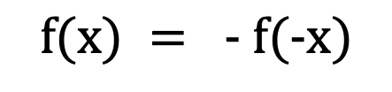
Sine Wave
Properties Of Function
Continuous Vs Discrete
Symmetry Properties
Even Functions
Odd Functions
Periodic
A-periodic
Linear
4. Orthogonality
$$f(x) = − f(−x)$$

Slide 12
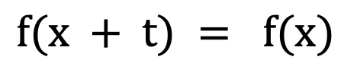
Sine Wave
Properties Of Function
Continuous Vs Discrete
Symmetry Properties
Even Functions
Odd Functions
Periodic
A-periodic
Linear
4. Orthogonality
$$f(x + t) = f(x)$$

Slide 13
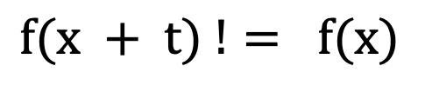
Sine Wave
Properties Of Function
Continuous Vs Discrete
Symmetry Properties
Even Functions
Odd Functions
Periodic
A-periodic
Linear
4. Orthogonality
$$f(x + t) != f(x)$$

Slide 14
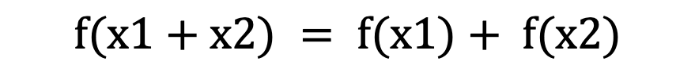
Functions
Properties Of Function
Continuous Vs Discrete
Symmetry Properties
Even Functions
Odd Functions
Periodic
A-periodic
Linear
4. Orthogonality
$$f(x1+x2) = f(x1)+ f(x2)$$

Slide 15
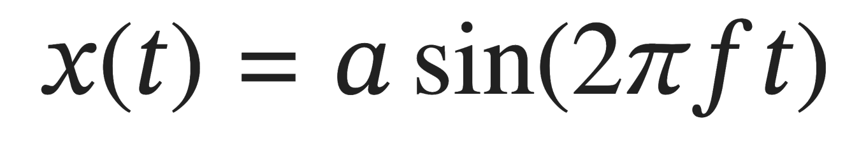
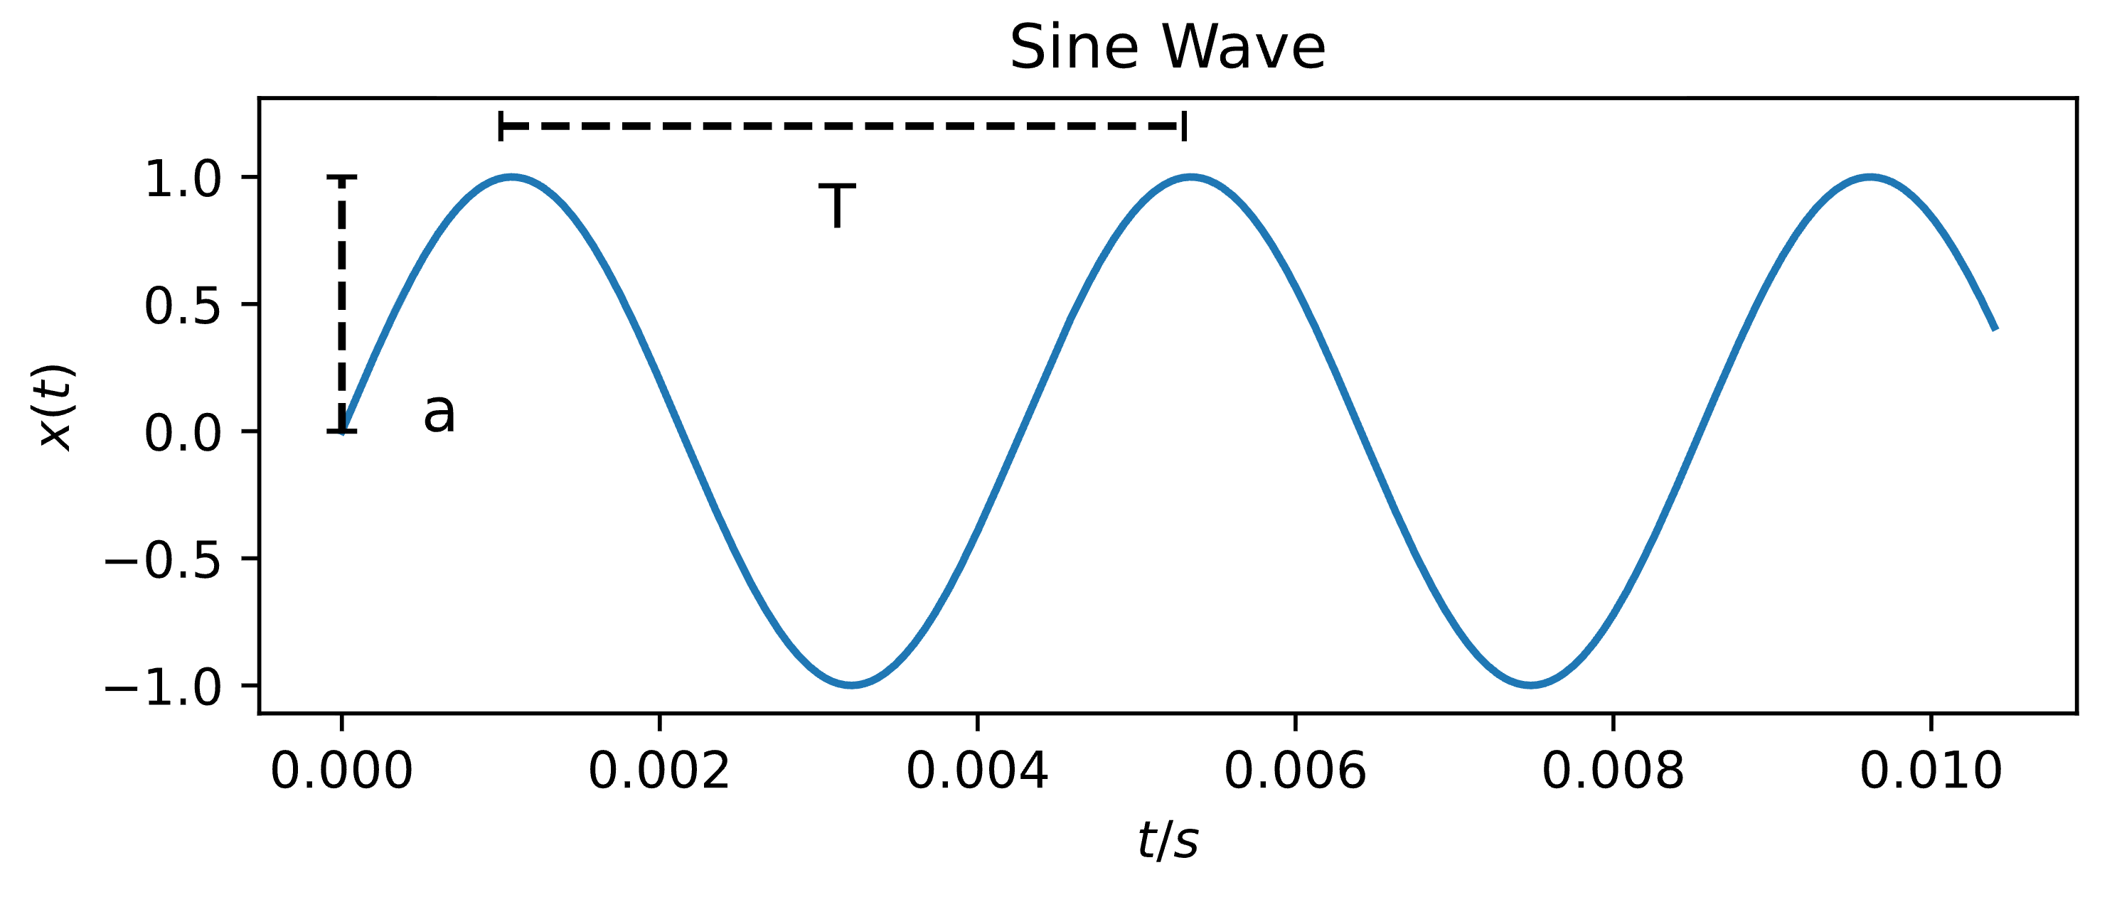
Sine Wave
A Sine Wave

Slide 16
Sine Wave
A Sine Wave
Sine values at points in time t

Slide 17
Sine Wave
A Sine Wave
Amplitude, here a = 1

Slide 18
Sine Wave
A Sine Wave
Angular Frequency

Slide 19
Sine Wave
A Sine Wave
Points in Time

Slide 20
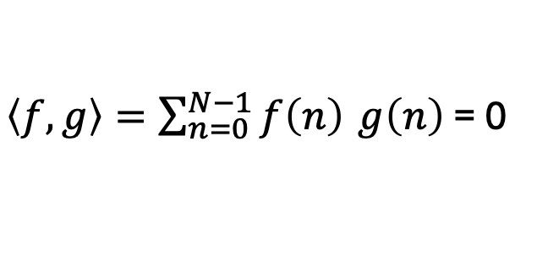
Sine Wave
Properties Of Function
Continuous Vs Discrete
Symmetry Properties
Even Functions
Odd Functions
Periodic
A-periodic
Linear
4. Orthogonality
$\left\langle f,g\right\rangle =\sum_{n=0}^{N−1}{f\left(n\right)} g\left(n\right)$ = 0
[Inner Product = 0 !!]

Slide 21
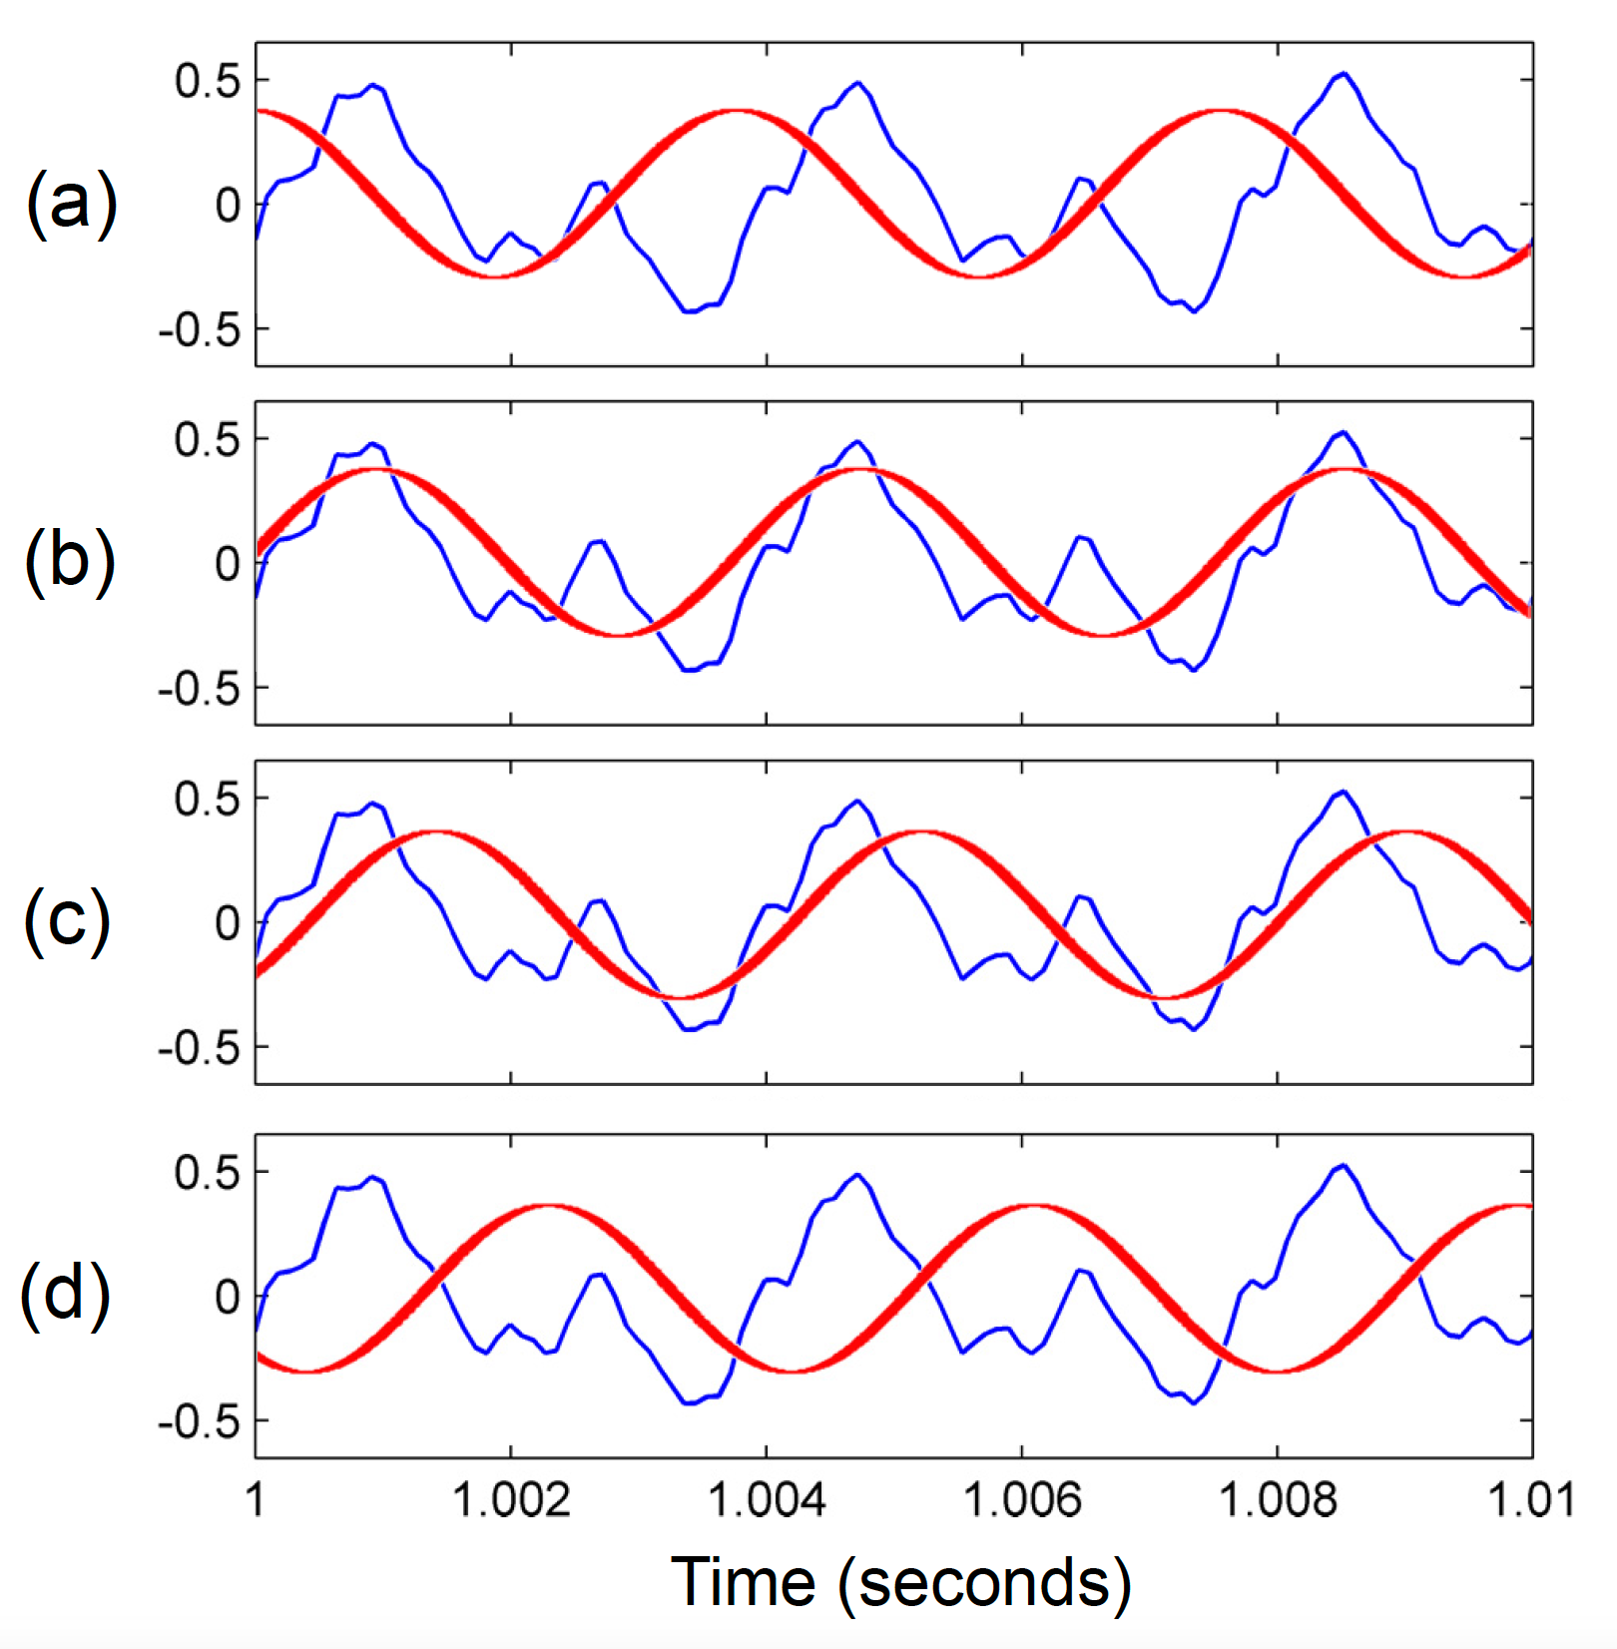
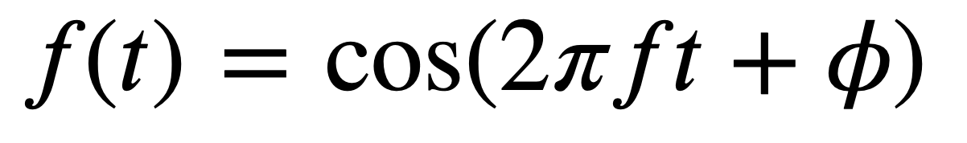
Sine Wave
Phase
https://www.desmos.com/calculator/9useprq8i8

Slide 22
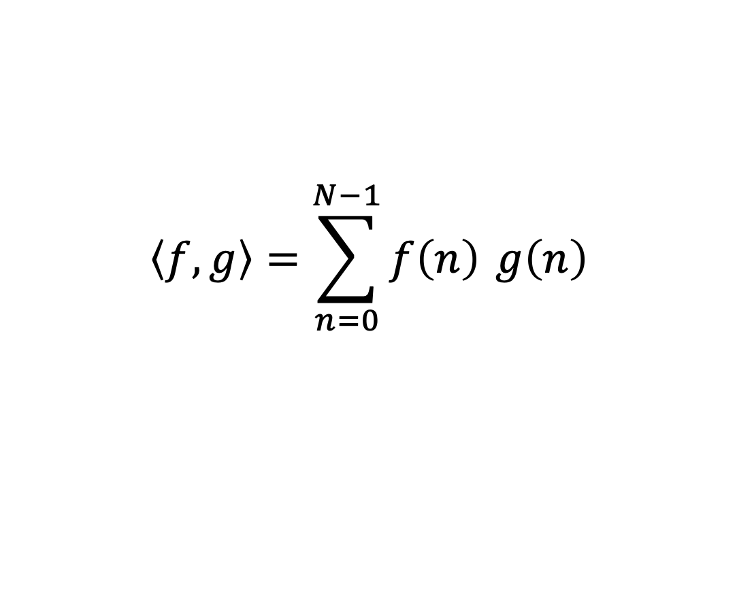
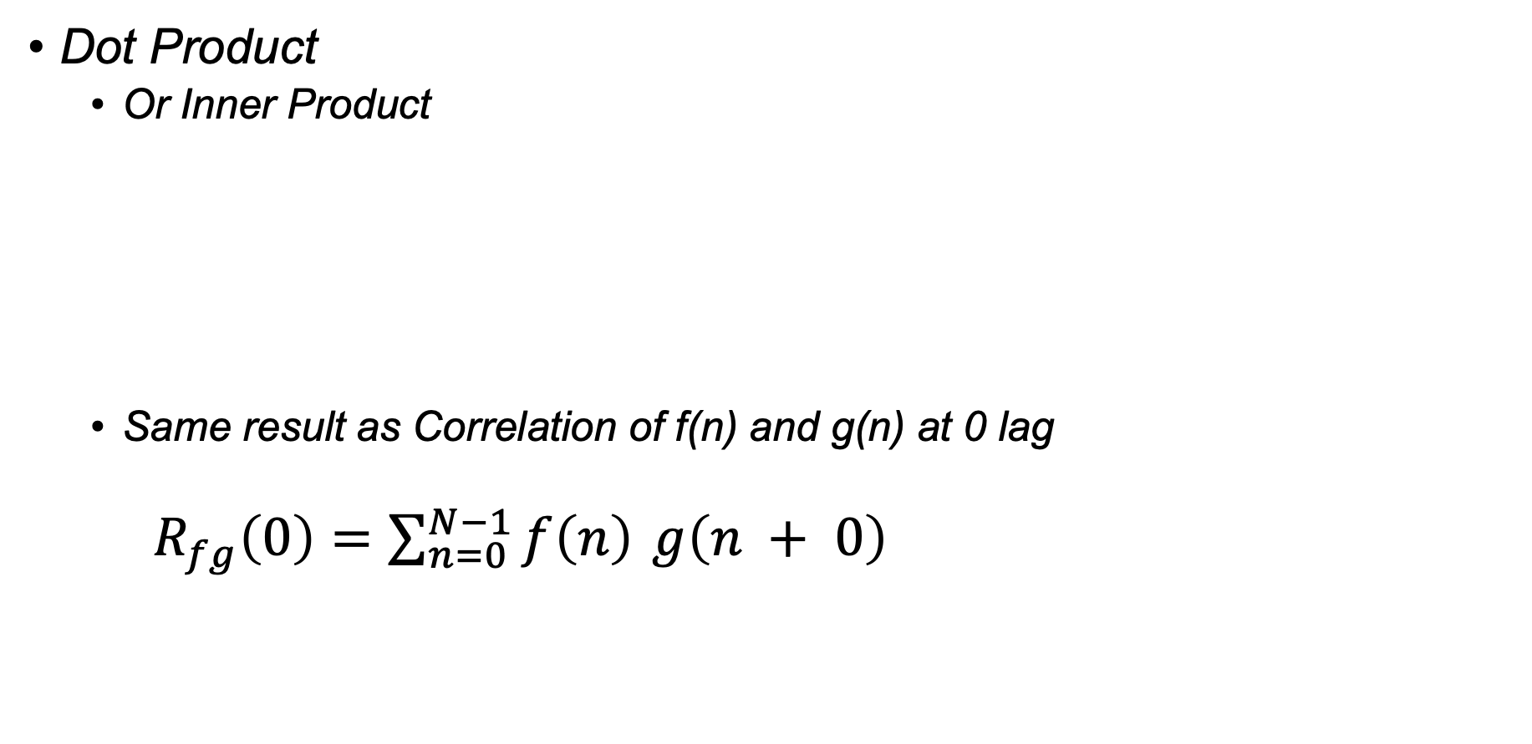
Computing Similarity
Dot Product
Or Inner Product
Same result as Correlation of f(n) and g(n) at 0 lag
$R_{fg}\left(0\right)=\sum_{n=0}^{N−1}{f\left(n\right)} g\left(n + 0\right)$
$$\left\langle f,g\right\rangle =\sum_{n=0}^{N−1}{f\left(n\right)} g\left(n\right)$$

Slide 23
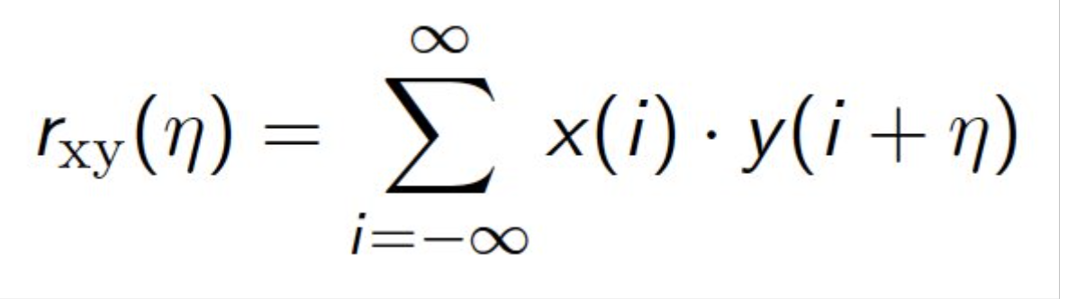
Computing Similarity
Dot Product
Or Inner Product
Same result as Correlation of f(n) and g(n) at 0 lag
$R_{fg}\left(0\right)=\sum_{n=0}^{N−1}{f\left(n\right)} g\left(n + 0\right)$
Remember This!!
$$\left\langle f,g\right\rangle =\sum_{n=0}^{N−1}{f\left(n\right)} g\left(n\right)$$

Slide 24
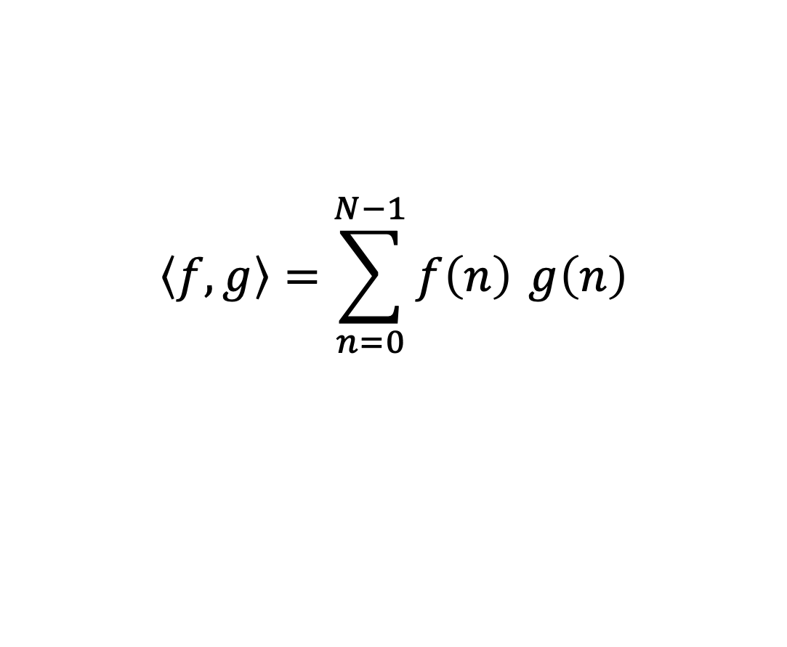
Activity Computing Similarity
Dot Product
Or Inner Product
Of Target Signal and Sinusoids
https://dev.nonety.pe/~/audio_synth_example?room=sinecorrelation
$$\left\langle f,g\right\rangle =\sum_{n=0}^{N−1}{f\left(n\right)} g\left(n\right)$$

Slide 25
Activity Computing Similarity
Steps
Download Wavfiles from Files in Canvas (Audio/CorrelationActivity)
Use the hints in the file name to complete the missing code logic
Plot and share what frequencies are present in these audio wavefiles with the simple dot product code provided

Slide 26
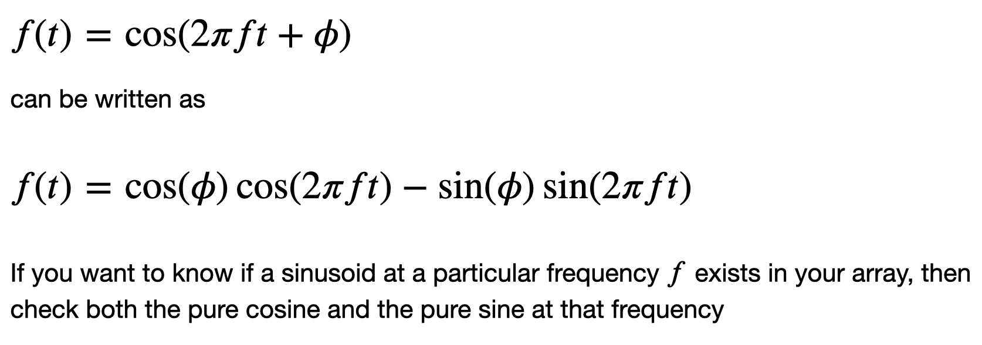
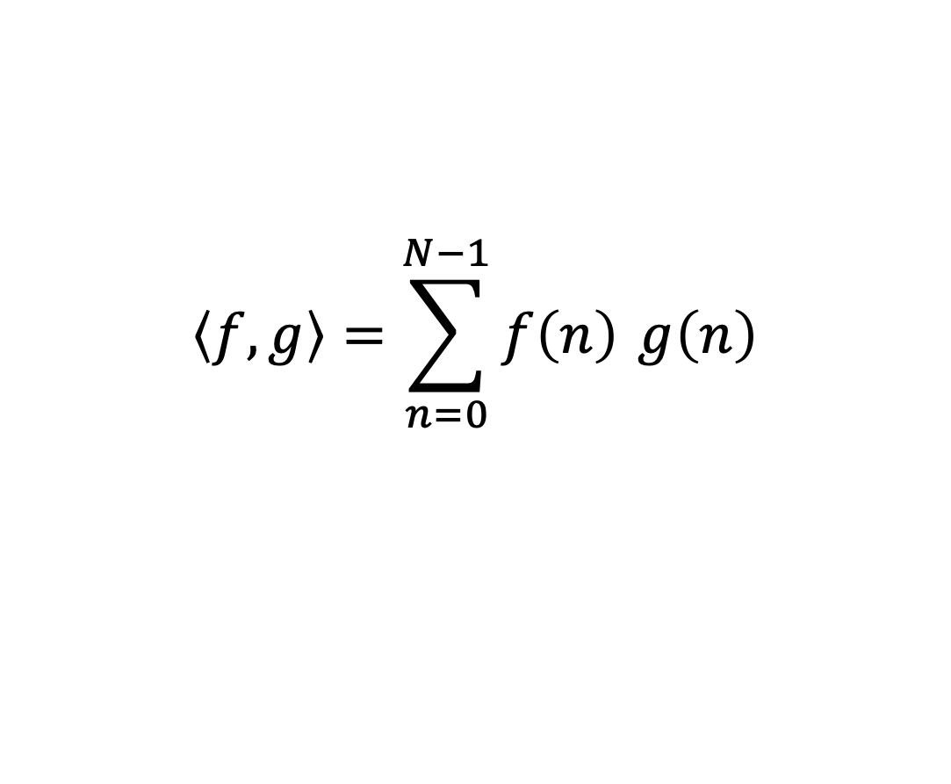
Activity Computing Similarity
$$\left\langle f,g\right\rangle =\sum_{n=0}^{N−1}{f\left(n\right)} g\left(n\right)$$

Slide 27
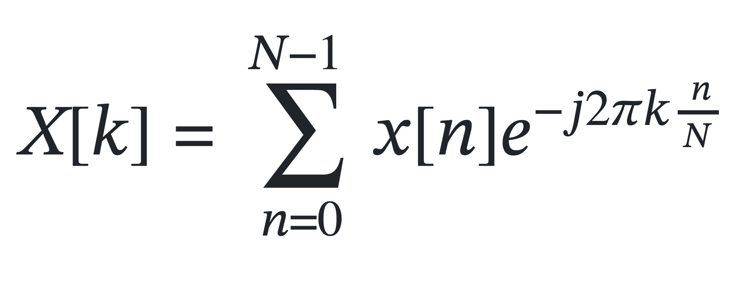
Discrete Fourier Transform

Slide 28
Discrete Fourier Transform

Slide 29
Discrete Fourier Transform

Slide 30
Discrete Fourier Transform
For a Signal Of N discrete points, You get N discrete Frequency Bins

Slide 31
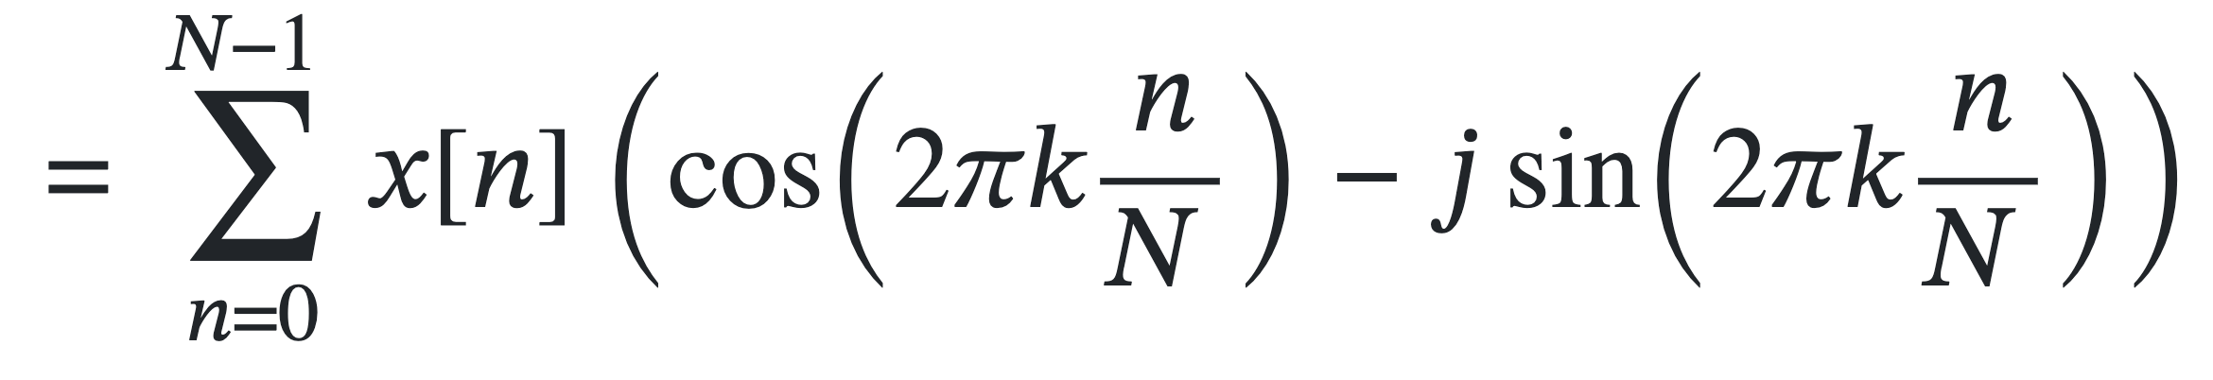
Discrete Fourier Transform

Slide 32
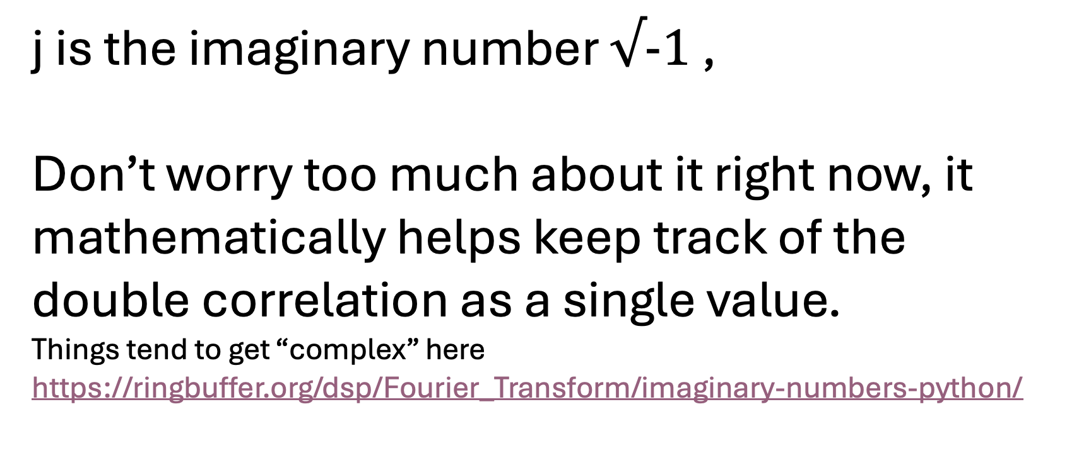
Discrete Fourier Transform
j is the imaginary number $√−1$ ,
Don’t worry too much about it right now, it mathematically helps keep track of the double correlation as a single value.
Things tend to get “complex” here
https://ringbuffer.org/dsp/Fourier_Transform/imaginary-numbers-python/

Slide 33
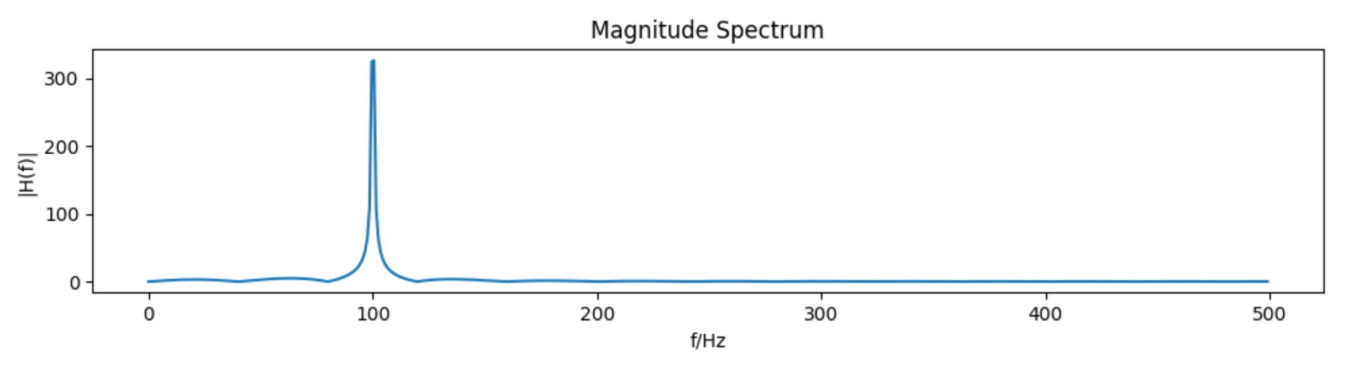
Discrete Fourier Transform
What do we care about?
Magnitude Spectrum
Phase Spectrum

Slide 34
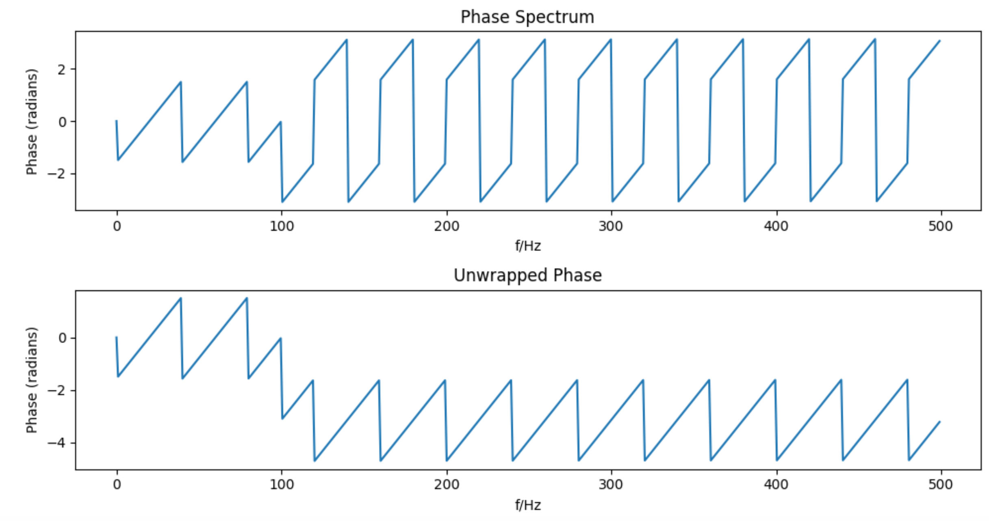
Discrete Fourier Transform
What do we care about?
Phase Spectrum
Phase Spectrum

Slide 35
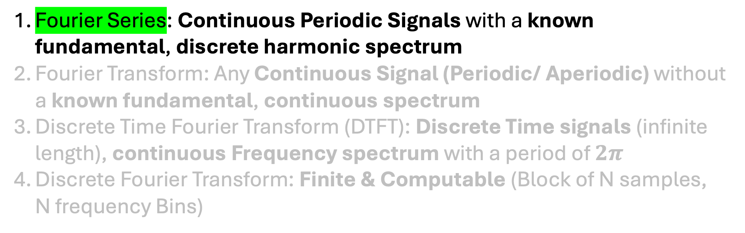
Story Of Fourier Transform
Fourier Series: Continuous Periodic Signals with a known fundamental, discrete harmonic spectrum
Fourier Transform: Any Continuous Signal (Periodic/ Aperiodic) without a known fundamental, continuous spectrum
Discrete Time Fourier Transform (DTFT): Discrete Time signals (infinite length), continuous Frequency spectrum with a period of $2π$
Discrete Fourier Transform: Finite & Computable (Block of N samples, N frequency Bins)

Slide 36
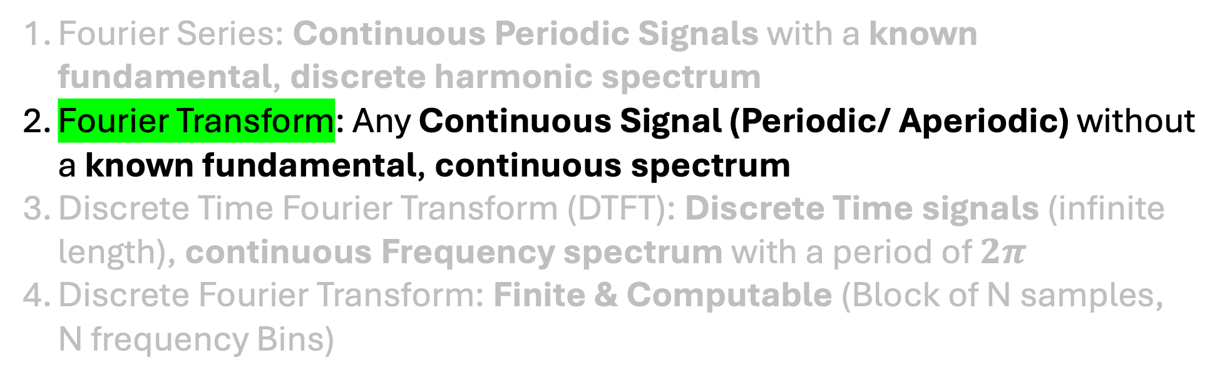
Story Of Fourier Transform
Fourier Series: Continuous Periodic Signals with a known fundamental, discrete harmonic spectrum
Fourier Transform: Any Continuous Signal (Periodic/ Aperiodic) without a known fundamental, continuous spectrum
Discrete Time Fourier Transform (DTFT): Discrete Time signals (infinite length), continuous Frequency spectrum with a period of $2π$
Discrete Fourier Transform: Finite & Computable (Block of N samples, N frequency Bins)

Slide 37
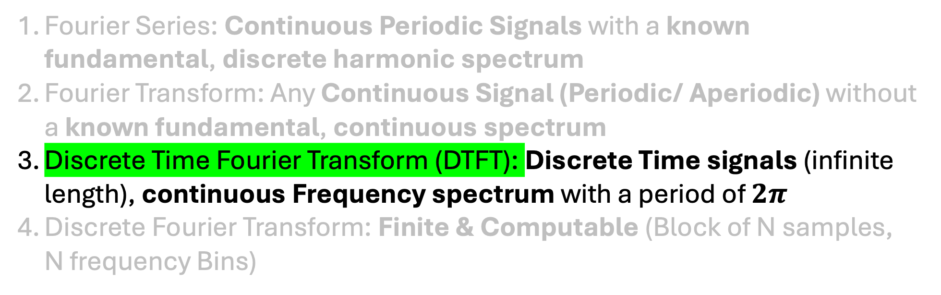
Story Of Fourier Transform
Fourier Series: Continuous Periodic Signals with a known fundamental, discrete harmonic spectrum
Fourier Transform: Any Continuous Signal (Periodic/ Aperiodic) without a known fundamental, continuous spectrum
Discrete Time Fourier Transform (DTFT): Discrete Time signals (infinite length), continuous Frequency spectrum with a period of $2π$
Discrete Fourier Transform: Finite & Computable (Block of N samples, N frequency Bins)

Slide 38
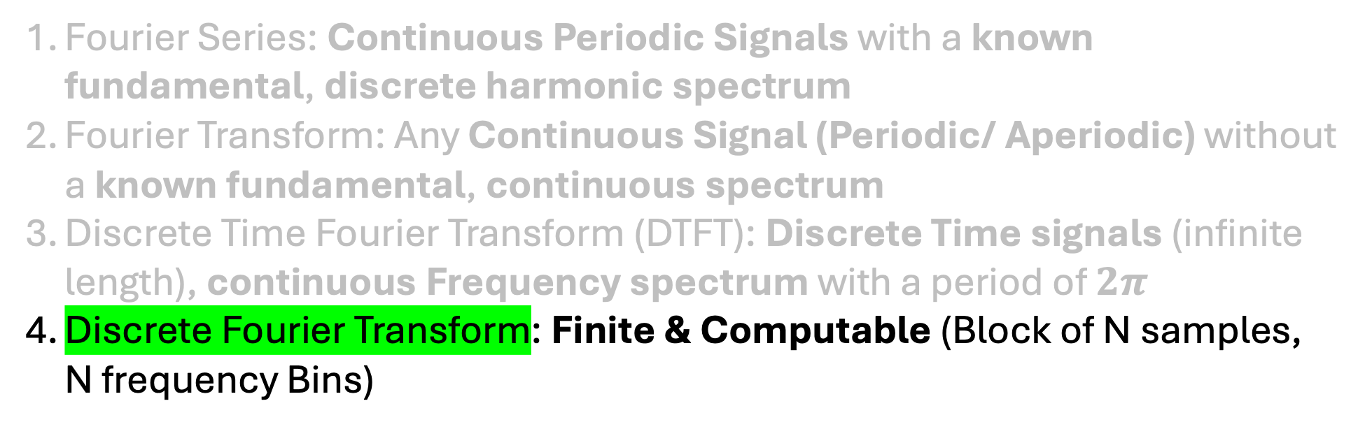
Story Of Fourier Transform
Fourier Series: Continuous Periodic Signals with a known fundamental, discrete harmonic spectrum
Fourier Transform: Any Continuous Signal (Periodic/ Aperiodic) without a known fundamental, continuous spectrum
Discrete Time Fourier Transform (DTFT): Discrete Time signals (infinite length), continuous Frequency spectrum with a period of $2π$
Discrete Fourier Transform: Finite & Computable (Block of N samples, N frequency Bins)

Slide 39
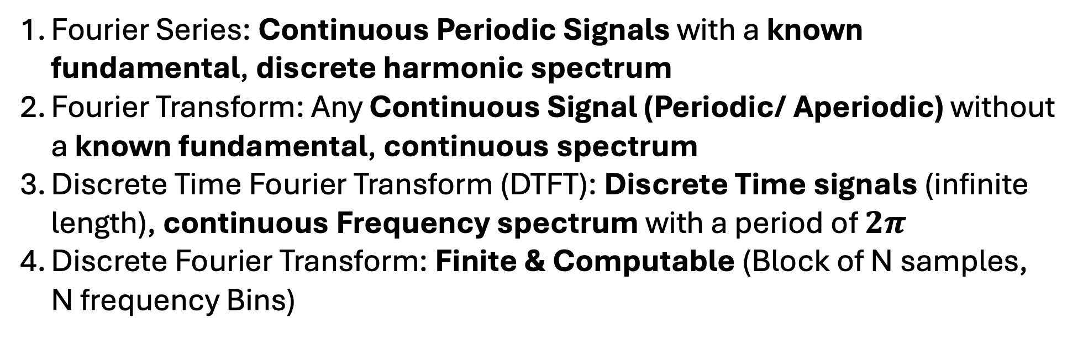
Story Of Fourier Transform
Fourier Series: Continuous Periodic Signals with a known fundamental, discrete harmonic spectrum
Fourier Transform: Any Continuous Signal (Periodic/ Aperiodic) without a known fundamental, continuous spectrum
Discrete Time Fourier Transform (DTFT): Discrete Time signals (infinite length), continuous Frequency spectrum with a period of $2π$
Discrete Fourier Transform: Finite & Computable (Block of N samples, N frequency Bins)

Slide 40
Fourier Transform Activity
Numpy FFT (Fast Fourier Transform)
The FFT delivers the exact same results a DFT does, but it uses more advanced algorithms in the implementation.
https://ringbuffer.org/dsp/Fourier_Transform/fft-python/
Use the waveforms from the previous activity
Use the fft function instead of dot product

Slide 41
Agenda
Frequency Resolution
Properties Of Discrete FFT
Short Time Fourier Transform
Spectrogram
Fundamental Frequency Detection

Slide 42
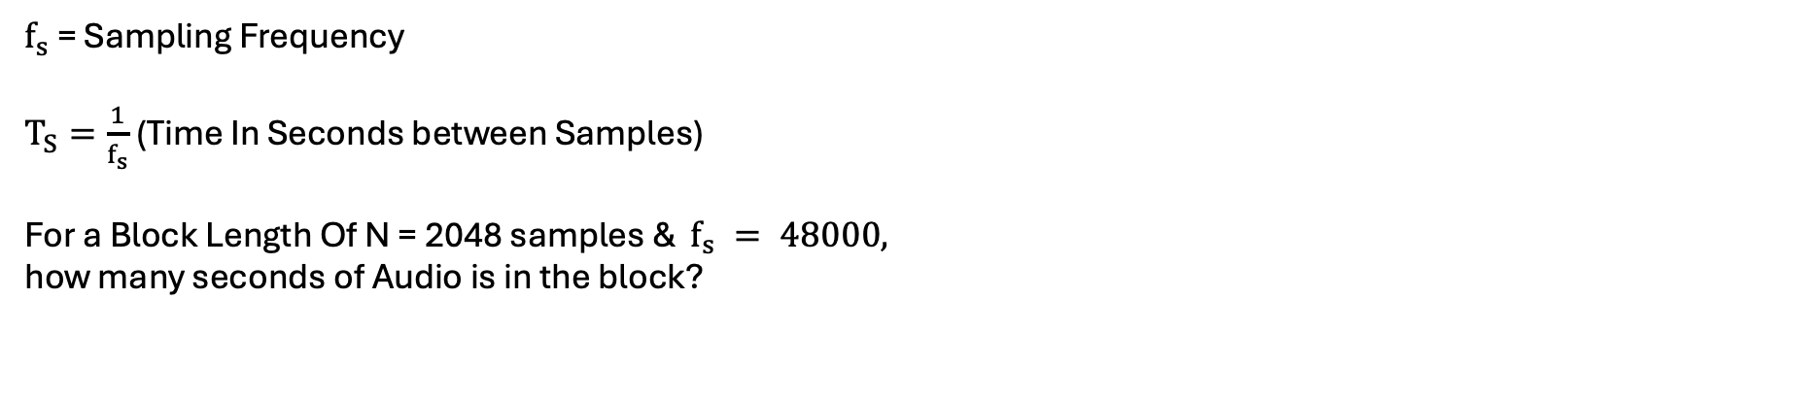
Frequency Resolution
$f_{s}$ = Sampling Frequency
$T_{S}=\frac{1}{f_{s}}$ (Time In Seconds between Samples)
For a Block Length Of N = 2048 samples & $f_{s} = 48000,$
how many seconds of Audio is in the block?

Slide 43
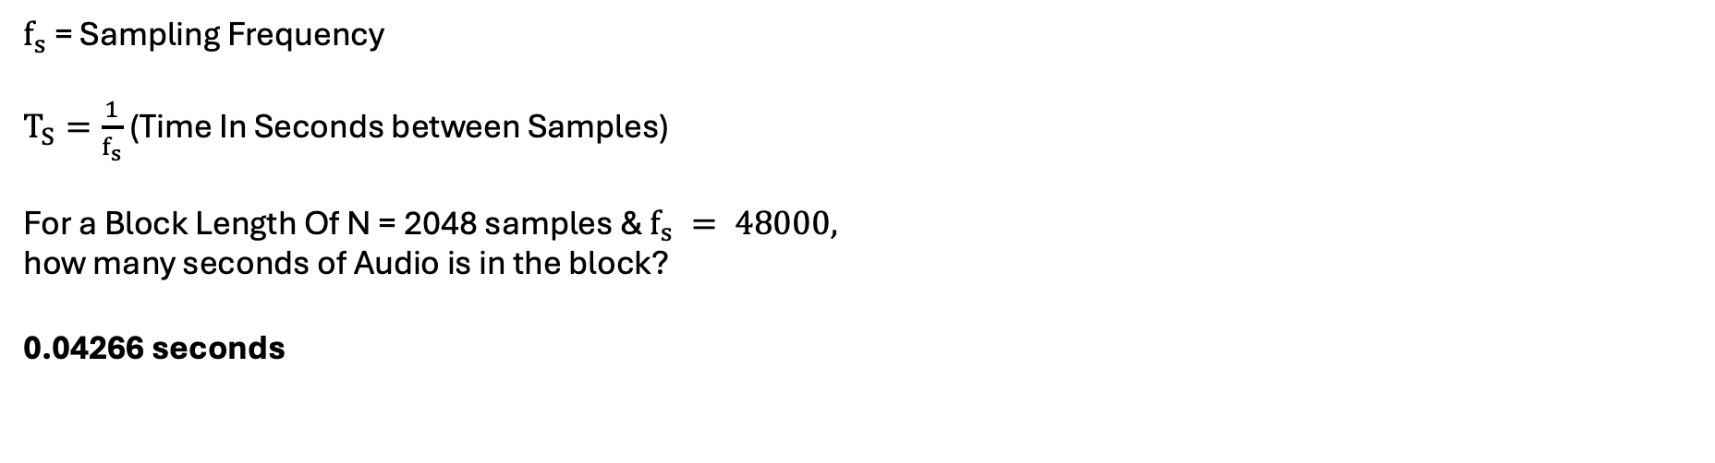
Frequency Resolution
$f_{s}$ = Sampling Frequency
$T_{S}=\frac{1}{f_{s}}$ (Time In Seconds between Samples)
For a Block Length Of N = 2048 samples & $f_{s} = 48000,$
how many seconds of Audio is in the block?
0.04266 seconds

Slide 44
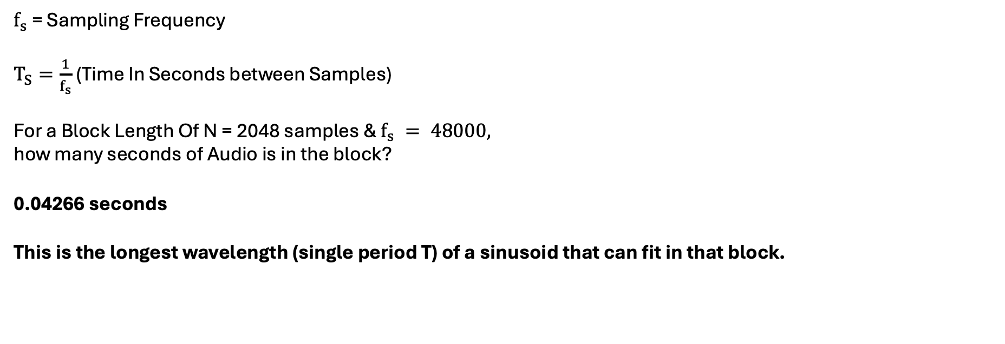
Frequency Resolution
$f_{s}$ = Sampling Frequency
$T_{S}=\frac{1}{f_{s}}$ (Time In Seconds between Samples)
For a Block Length Of N = 2048 samples & $f_{s} = 48000,$
how many seconds of Audio is in the block?
0.04266 seconds
This is the longest wavelength (single period T) of a sinusoid that can fit in that block.

Slide 45
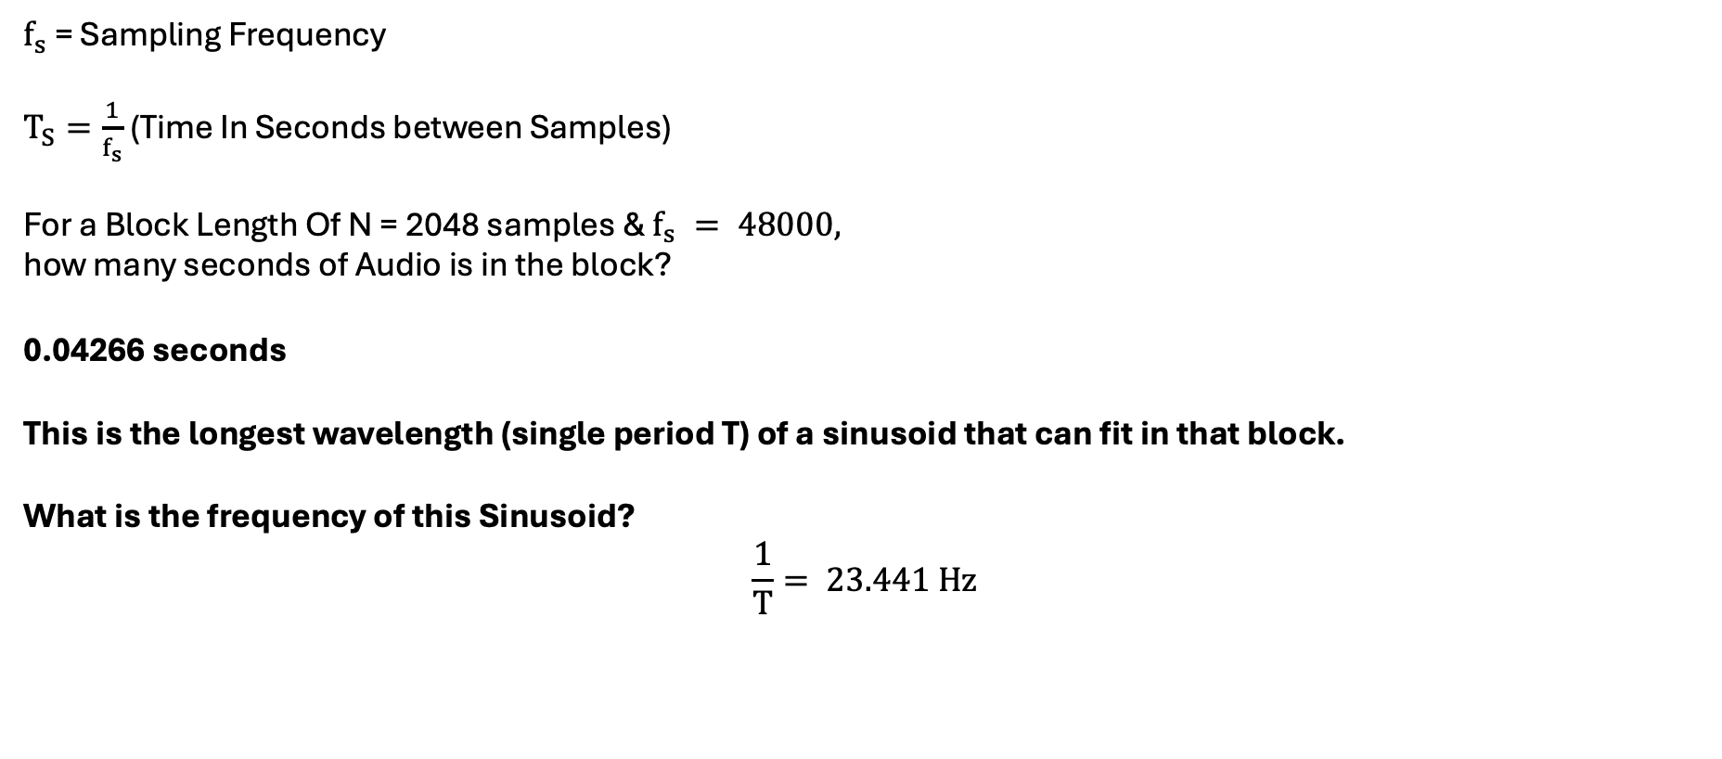
Frequency Resolution
$f_{s}$ = Sampling Frequency
$T_{S}=\frac{1}{f_{s}}$ (Time In Seconds between Samples)
For a Block Length Of N = 2048 samples & $f_{s} = 48000,$
how many seconds of Audio is in the block?
0.04266 seconds
This is the longest wavelength (single period T) of a sinusoid that can fit in that block.
What is the frequency of this Sinusoid?
$$\frac{1}{T}= 23.441 Hz$$

Slide 46
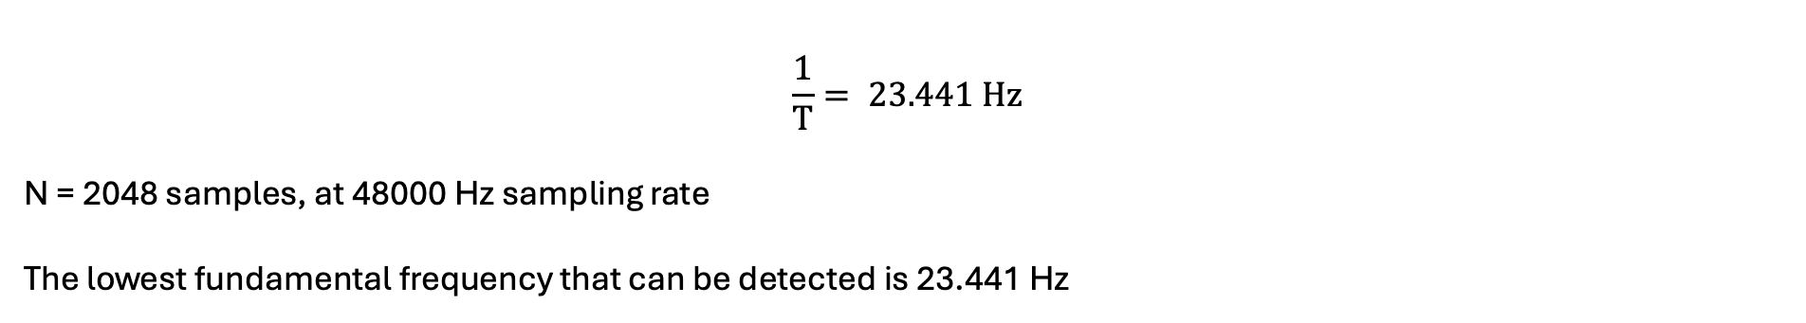
Frequency Resolution
$$\frac{1}{T}= 23.441 Hz$$
N = 2048 samples, at 48000 Hz sampling rate
The lowest fundamental frequency that can be detected is 23.441 Hz

Slide 47
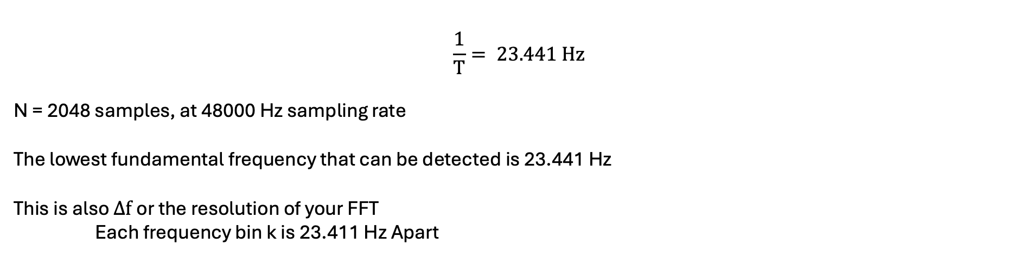
Frequency Resolution
$$\frac{1}{T}= 23.441 Hz$$
N = 2048 samples, at 48000 Hz sampling rate
The lowest fundamental frequency that can be detected is 23.441 Hz
This is also $∆f$or the resolution of your FFT
Each frequency bin k is 23.411 Hz Apart

Slide 48
Discrete Fourier Transform
For a Signal Of N discrete points, You get N discrete Frequency Bins

Slide 49
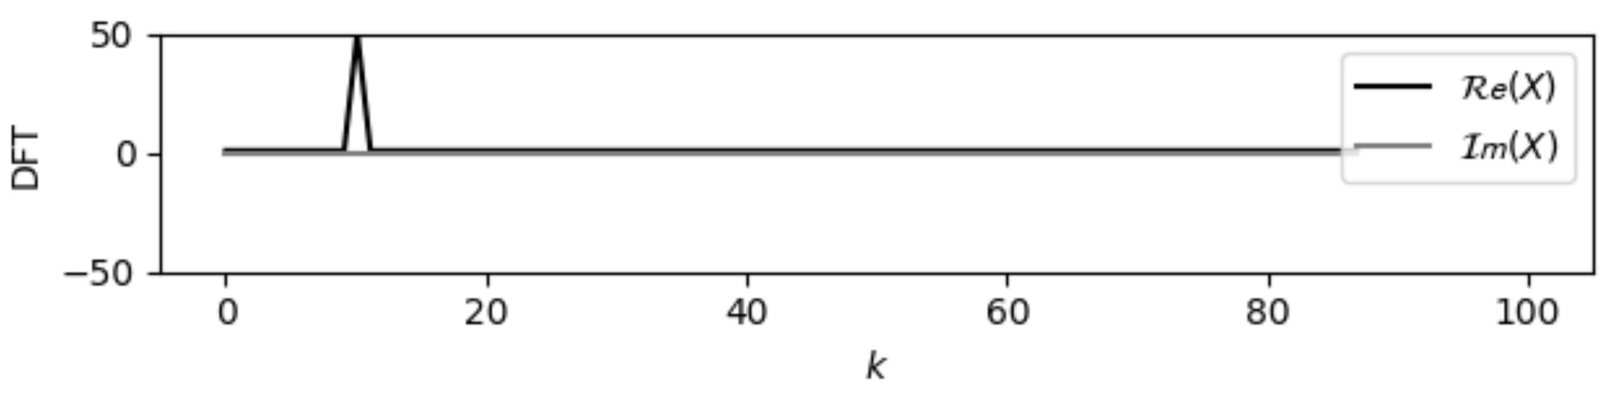
Discrete Fourier Transform
For a Signal Of N discrete points, You get N discrete Frequency Bins

Slide 50
Frequency Resolution
$f_{s}$ = Sampling Frequency
$T_{S}=\frac{1}{f_{s}}$ (Time In Seconds between Samples)
For a Block Length Of N = 2048 samples & $f_{s} = 48000,$
how many seconds of Audio is in the block?
0.04266 seconds
This is the longest wavelength (single period T) of a sinusoid that can fit in that block.
What is the frequency of this Sinusoid?
$$\frac{1}{T}= 23.441 Hz$$
This is the Lowest Possible Fundamental Frequency You can detect from a spectrum at this resolution

Slide 51
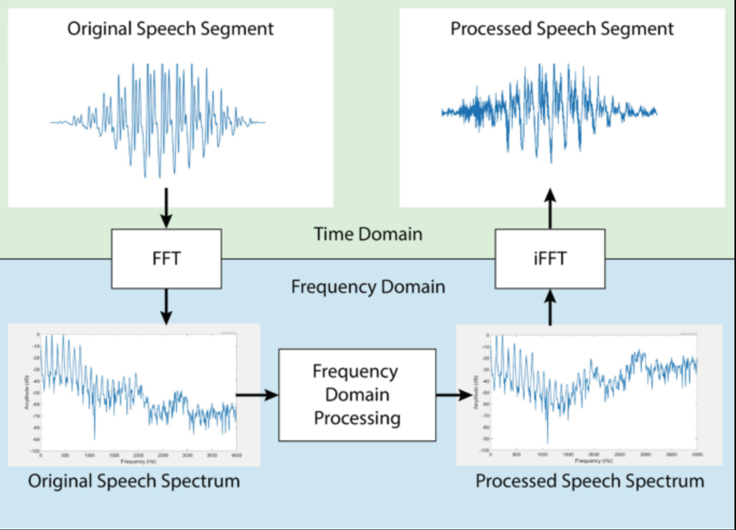
Properties Of Fourier Transform
DFT is invertible
From the FFT of a signal, you can recreate the time domain block with the inverse-FFT
https://ringbuffer.org/dsp/Fourier_Transform/fft-python/#IFFT-from-Magnitude-and-Phase
Source: https://link.springer.com/chapter/10.1007/978-3-031-15416-4_15

Slide 52
Properties Of Fourier Transform
DFT is invertible
Additionally, the signals energy is conserved throughout this process [Parseval’s Theorem]
https://ringbuffer.org/dsp/Fourier_Transform/fft-python/#IFFT-from-Magnitude-and-Phase

Slide 53
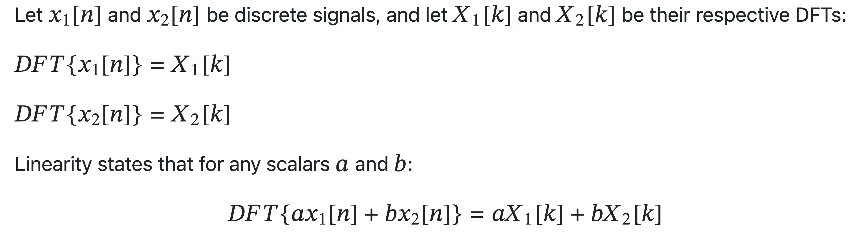
Properties Of Fourier Transform
2. DFT is linear

Slide 54
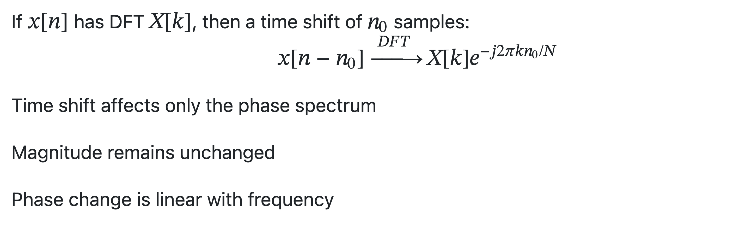
Properties Of Fourier Transform
3. Shifting The Signal In The Time Domain
These properties become
Important when you want to bring about
Augmentations to your audio data without affecting frequency content!!!

Slide 55
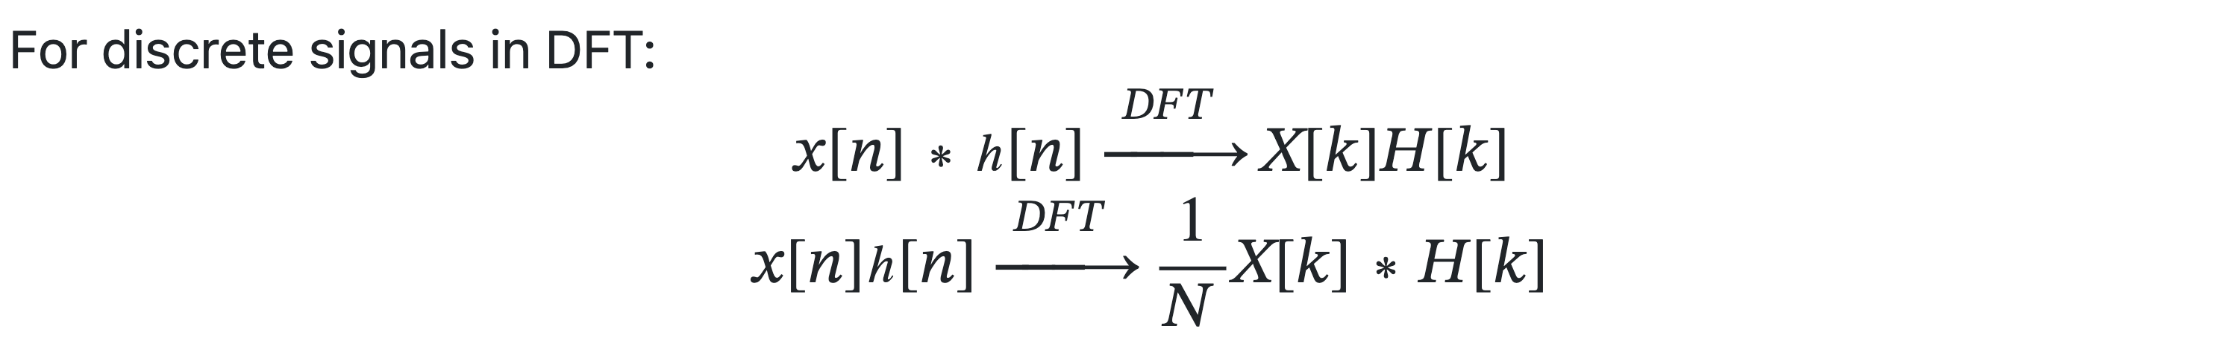
Properties Of Fourier Transform
4. Multiplying Two Signals in Time is Convolution In The Frequency Domain
https://ringbuffer.org/dsp/Signals_and_Operations/convolution/

Slide 56
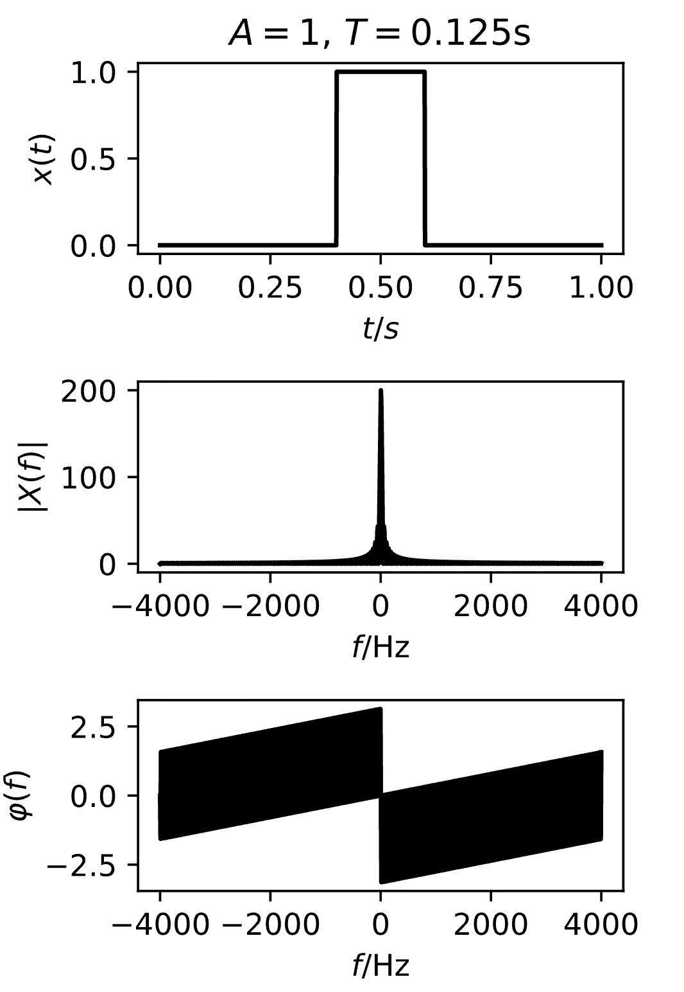
Properties Of Fourier Transform
Fourier Transform Of A Rectangular Pulse (Boxcar)

Slide 57

Properties Of Fourier Transform
Windowing
Consider a block of Audio

Slide 58

Properties Of Fourier Transform
Windowing
Consider a block of Audio

Slide 59
Properties Of Fourier Transform
Windowing
Consider a block of Audio
Multiplication
Of This section of audio with a rectangular block
x
Results in a convolution in the frequency domain, creating artifacts

Slide 60

Properties Of Fourier Transform
Windowing
https://ringbuffer.org/dsp/Fourier_Transform/window_functions/
Spectral Leakage needs to be minimized
The Fourier transforms of common window functions usually show a main lobe, with several side lobes.
A desirable window will have a narrow main lobe, allowing for good peak detection and low side-lobe level.
source: A. Lerch, An Introduction to Audio Content Analysis: Music Information Retrieval Tasks and Applications. Wiley-IEEE Press, 2023.

Slide 61
Properties Of Fourier Transform
Windowing
https://ringbuffer.org/dsp/Fourier_Transform/window_functions/
Spectral Leakage needs to be minimized
The Fourier transforms of common window functions usually show a main lobe, with several side lobes.
A desirable window will have a narrow main lobe, allowing for good peak detection and low side-lobe level.

Slide 62
Properties Of Fourier Transform
Windowing
https://ringbuffer.org/dsp/Fourier_Transform/window_functions/
Our choice of window depends on
main lobe width
• how much does the main lobe “smear” a peak
side lobe height
• how dominant is the (highest) side lobe
side lobe attenuation/fall-off
• how much influence have distant sidelobes

Slide 63

STFT & Spectrogram
source: A. Lerch, An Introduction to Audio Content Analysis: Music Information Retrieval Tasks and Applications. Wiley-IEEE Press, 2023.

Slide 64


STFT & Spectrogram
https://librosa.org/doc/0.11.0/generated/librosa.feature.melspectrogram.html#librosa.feature.melspectrogram
https://docs.scipy.org/doc/scipy/reference/generated/scipy.signal.ShortTimeFFT.html
https://dev.nonety.pe/~/audio_synth_example?room=spectrogram

Slide 65
Review
What is A Sine Wave
What is a function?
How do we define a Sine Wave
The Discrete Fourier Transform
Properties Of Discrete FFT
STFT & Spectrogram

